Slide 1


Unit 4
Medicines and commodities
Notes:
Welcome to Unit 4 of Module 5.

Slide 2
By the end of this unit, you will be able to:
assess and record data on availability of medicines and commodities at various service sites within a health facility
Notes:
By the end of this unit, you will be able to correctly assess and record data on availability of medicines and commodities at various service sites within a health facility.

Slide 3
Medicines availability
The response options regarding the availability of medicines and commodities look different from those for the availability of equipment.
Equipment
Medicines and commodities
OBSERVED
AT LEAST ONE NOT EXPIRED
REPORTED, NOT SEEN
AVAILABLE BUT EXPIRED
NOT AVAILABLE
REPORTED AVAILABLE BUT NOT SEEN
NOT AVAILABLE TODAY
NEVER AVAILABLE
Notes:
The response options regarding the availability of medicines and commodities look a bit different from those for the availability of equipment.
Instead of the three options of “OBSERVED”, “REPORTED, NOT SEEN”, AND “NOT AVAILABLE”, we will instead find the following five options:
“AT LEAST ONE NOT EXPIRED”;
“AVAILABLE BUT EXPIRED”;
“REPORTED AVAILABLE BUT NOT SEEN”;
“NOT AVAILABLE TODAY”;
“NEVER AVAILABLE”.
Let’s look at these in more detail.

Slide 4
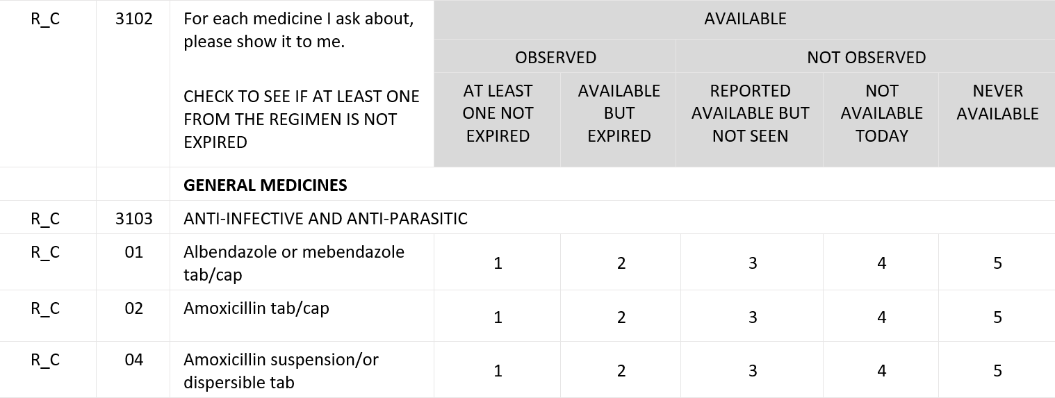
Medicines availability
the data collector will need to look at the expiry date.
If the medicine was seen,
Notes:
If the medicine or commodity was seen in the service site – or in the main storage site for pharmaceuticals, depending on where the data collector is gathering the information – the data collector will need to look at the expiry date of the medicine or commodity and record either:
“AT LEAST ONE NOT EXPIRED” if at least one item of the appropriate dosage is in stock and within the expiry date; or
“AVAILABLE BUT EXPIRED” if the item is in stock but beyond the expiry date.

Slide 5
Medicines availability
the data collector will need to record:
If the medicine was not seen,
Notes:
If the item was not seen in the service site or in the main storage site for pharmaceuticals, the data collector will need to record:
“REPORTED AVAILABLE BUT NOT SEEN” if the respondent says the item is available but cannot show it to the data collector; or

Slide 6
Medicines availability
the data collector will need to record:
If the medicine was not seen,
Notes:
“NOT AVAILABLE TODAY” if the respondent says that the item is usually available, but not on the day of the visit; or

Slide 7
Medicines availability
the data collector will need to record:
If the medicine was not seen,
Notes:
“NEVER AVAILABLE” if the data collector reports the item is not observed and the respondent says that the item is never available.

Slide 8
You have now completed Unit 4.
In the next unit, we will look at data collection on support for quality services.
Notes:
You have now completed Unit 4.
In the next unit, we will look at data collection on support for quality services.

